Slide 1
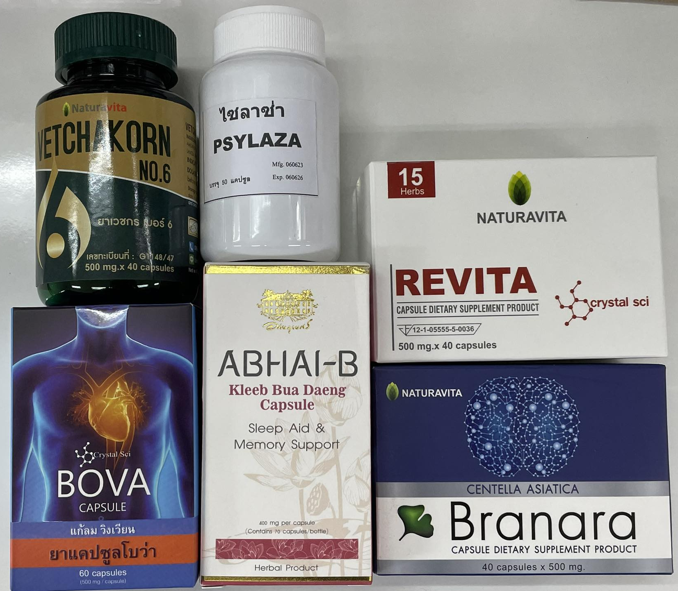
Alzheimer
: Acetylcholinesterase (AChE)
Sample dissolved
in Absolute Ethanol
Relative at 1 mg/mL
IC₅₀ of ABHI-B, Branara, Revita, Bova and Psylaza: 4mg/mL 2-fold dilution
IC₅₀ of Vet No.6: 10mg/mL 3-fold dilution
Notes:
ABHI-B, Branara, Revita, Bova and Psylaza start 4mg/mL 2-fold dilution
Vet No.6 start 10mg/mL 3-fold dilution

