Slide 1
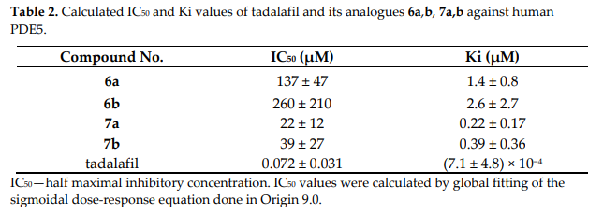
PDE5 Assay
: Detected by Fluorescence
Negative Control
Positive Control
Check enzyme activity
Diketopiperazine-Based_Flexible_Tadalafil_Analogue.pdf
2.568 µM

Slide 2
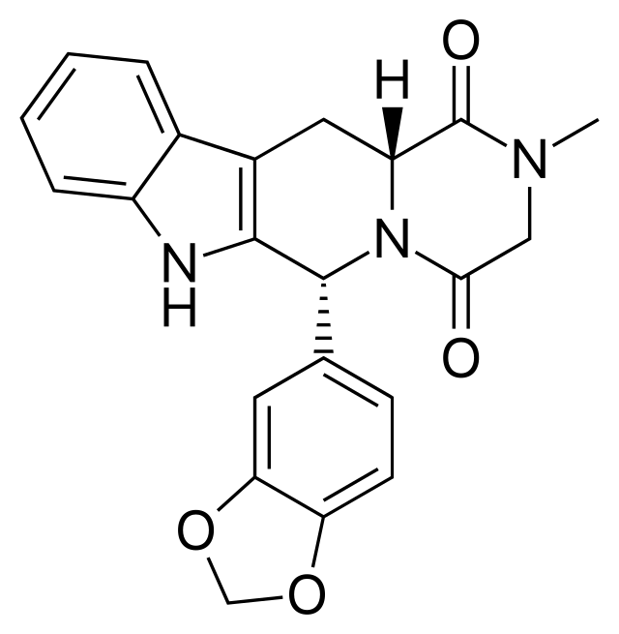
IC₅₀ of Tadalafil with PDE5
Tadalafil
(Mw. 389.404 g/mol)
Link of Paper | IC₅₀ value
Diketopiperazine-Based_Flexible_Tadalafil_Analogue.pdf | 72 nM
The selectivity and potency of the new PDE5 inhibitor TPN729MA - PubMed (nih.gov) | 2.35 nM
Pharmaceuticals | Free Full-Text | Advancements in Phosphodiesterase 5 Inhibitors: Unveiling Present and Future Perspectives (mdpi.com) | 2 nM
Urogenital Diseases/Disorders, Sexual Dysfunction and Reproductive Medicine: Overview - ScienceDirect | 3.6 nM
(PDF) Phosphodiesterase (PDE5) inhibition assay for rapid detection of erectile dysfunction drugs and analogs in sexual enhancement products (researchgate.net) | 1.13 ng/mL
28.04 ng/mL
0.92 ng/mL
0.78 ng/mL
1.40 ng/mL

Slide 3
PDE5 Assay

Slide 4
PDE5 Assay

Slide 6
PDE5 Assay

